Slide 1

Chapter 23
Managing Interest Rate Risk and Insolvency Risk on the Balance Sheet
© McGraw Hill LLC. All rights reserved. No reproduction or distribution without the prior written consent of McGraw Hill LLC.

Slide 2
Interest Rate Risk
Asset-transformation function performed by financial institutions (F I’s) often exposes them to interest rate risk via the mismatching of asset and liability maturities.
F I’s use two main methods to measure interest rate exposure:
Repricing gap (that is, funding gap) model examines the impact of interest rate changes on an F I’s net interest income (N I I).
Duration gap model incorporates the impact of interest rate changes on the overall market value of an F I’s balance sheet and ultimately on its owners’ equity or net worth.
Insolvency risk is the result, a consequence, or an outcome of excessive amounts of one or more of the risks taken by an F I (for example, liquidity risk, credit risk, and interest rate risk).
Notes:
NII is the difference between an FI’s interest income and interest expense.

Slide 3
Interest Rate Risk Measurement and Management
Federal Reserve’s monetary policy strategy is the most direct influence on the level and movement of interest rates.
If the Fed wants to slow down the economy, it will tighten monetary policy by taking actions that raise interest rates.
  Results in a decrease in business and household spending.
If the Fed wants to stimulate the economy (that is, expansionary monetary policy), it allows interest rates to fall.
  Promotes borrowing and spending.
Until recently, bank regulators based evaluations of bank interest rate risk on the repricing gap model alone.
While the repricing gap model is still used to measure interest rate risk in most F I’s, it is increasingly being used in conjunction with the duration gap model.

Slide 4
Repricing Model 1
Repricing or funding gap is the difference between those assets whose interest rates will be repriced or changed over some future period (R S A’s) and liabilities whose interest rates will be repriced or changed over some future period (R S L’s).
Simple model used by small F I’s in the U S.
Model is essentially a book value accounting cash flow analysis of the interest income earned on an F I’s assets and the interest expense paid on its liabilities (or its net interest income) over some particular period.
Using this approach, D I’s report quarterly on their Call Reports, interest-rate sensitivity reports which show the repricing gaps for assets and liabilities with various maturities.

Slide 5
Repricing Gaps for an F I
 | Assets | Liabilities | Gaps
1. 1 day. | $ 20 | $ 30
2. More than 1 day–3 months. | 30 | 40
3. More than 3 months–6 months. | 70 | 85
4. More than 6 months–12 months. | 90 | 70 | +20
5. More than 1 year–5 years. | 40 | 30 | +10
6. More than 5 years. | 10 | 5 | +5
 | $260 | $260
Notes:
Table 23–1 shows the assets and liabilities of an FI categorized into six maturity buckets. For simplicity, we assume equity is equal to zero.

Slide 6
Repricing Model 2
Gap in each maturity bucket (or bin) is calculated by estimated the difference between the rate-sensitive assets (R S A’s) and the rate-sensitive liabilities (R S L’s).
Rate sensitivity is the time to repricing of an asset or liability.
Repricing model measures the change in an F I’s net interest income exposure (or profit exposure) to interest rate changes in each different maturity bucket.
Negative gap (where R S A < R S L) exposes the F I to refinancing risk, the risk that the cost of rolling over or reborrowing funds will rise above the returns being earned on asset investments.
A positive gap (where R S A > R S L) exposes the F I to reinvestment risk, the risk that the returns on funds to be reinvested will fall below the cost of the funds.
Notes:
Note that repricing could be the result of a rollover of an asset or liability, or it can occur if the asset of liability is a variable-rate instrument.

Slide 7
Change in Net Interest Income
Change in net interest income in the ith maturity bucked is calculated as follows:
Change in net interest income in the ith maturity bucket.
Dollar size of the gap between the book value of rate-sensitive assets and rate-sensitive liabilities in maturity bucket i.
Change in the level of interest rates impacting assets and liabilities in the ith maturity bucket.

Slide 8
Cumulative Gaps (C G A P)
F I manager can also estimate cumulative gaps (C G A P) over various repricing categories or buckets.
Common C G A P of interest is the one-year repricing gap.
Cumulative effect on a bank’s net interest income may be estimated using:
C G A P effect is the relation between changes in interest rates and changes in net interest income.

Slide 9
Impact of Rate Changes on Net Interest Income When C G A P is Positive
Example: Impact of Rate Changes on Net Interest Income When C G A P Is Positive.
Suppose that, for the bank depicted in Table 23.2, interest rates rise by 1 percent on both R S A’s and R S L’s. The C G A P would project the expected annual change
in net interest income
of the bank as:
Similarly, if interest rates fall equally for R S A’s and R S L’s (row 2, Table 23–4), N I I will fall when C G A P is positive. As rates fall, interest income falls by more than interest expense. Thus, Nil falls. Suppose that for our bank, rates fall by 1 percent. The C G A P predicts that N I I will fall by:

Slide 10
Spread Effect
Spread effect is the effect that a change in the spread between rates on R S A’s and R S L’s has on net interest income (N I I) as interest rates change.
In general, the spread effect is such that, regardless of the direction of the change in interest rates, a positive relation exists between changes in the spread (between rates on R S A’s and R S L’s) and changes in N I I.
When the spread increases (decreases), N I I increases (decreases).

Slide 11
Impact of Spread Effect on Net Interest Income
Example: Impact of Spread Effect on Net Interest Income.
To understand spread effect, assume for a moment that both R S A’s and R S L’s equal $155 mi11ion. Suppose that rates rise by 1.2 percent on R S A’s and by 1 percent on R S L’s (that is, the spread
between the rate on R S A’s and R S L’s increases by 1.2 percent
percent = 0.2 percent). The resulting change in N I I is calculated as:

Slide 12
Weaknesses of the Repricing Model
Repricing model has four major weaknesses.
It ignores market value effects of interest rate changes.
  Repricing gap is only a partial and short-term measure of overall interest rate exposure.
It ignores cash flow patterns within a maturity bucket.
  On average, liabilities may be repriced toward the end of the bucket’s range and assets may be repriced toward the beginning.
It fails to deal with the problem of rate-insensitive asset and liability cash flow runoffs and prepayments.
  F I receives runoff from its rate-insensitive portfolio that can be reinvested at current market rates.
It ignores cash flows from off-balance-sheet (O B S) activities.
  Changes in interest rates will affect the cash flows on many O B S instruments, as well as those listed on the balance sheet.

Slide 13
Duration Gap Model 1
Duration measures the interest rate sensitivity of an asset or liability’s value to small changes in interest rates.
Duration gap is a measure of overall interest rate risk exposure for an F I.
To estimate the overall duration gap of an F I:
Determine the duration of an F I’s asset portfolio (A) and the duration of its liability portfolio (L).
Calculate the market value weighted average of the duration of the assets (or liabilities) in the portfolio.

Slide 14
Duration Gap Model 2
The dollar change in the market value of the asset portfolio for a change in interest rates is:
Similarly, the dollar change in the market value of the liability portfolio for a change in interest rates is:
Rearranging and combining these equations results in a measure of the change in the market value of equity:

Slide 15
Duration Gap Model 3
Effect of interest rate changes on the market value of an F I’s equity or
net worth
breaks down into three effects:
Leverage-adjusted duration gap
  Measured in years and reflects degree of duration mismatch in an F I’s balance sheet.
  The larger this gap in absolute terms, the more exposed the F I is to interest rate risk.
Size of the F I.
  A measures the size of the F I’s assets; the larger the asset size, the larger the dollar size of the potential net worth exposure from any given interest rate shock.
Size of the interest rate shock
  The larger the shock, the greater the F I’s exposure.

Slide 16
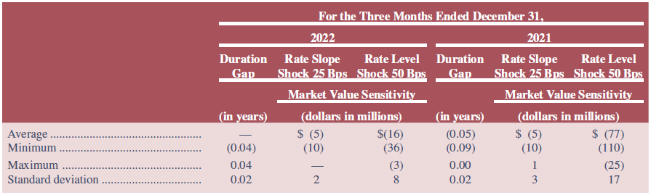
Fannie Mae Duration Gap
Source: Fannie Mae’s Annual Report on Form 10-K for the year ended December 31, 2022, www.fanniemae.com.
Access the text alternative for slide images.
Notes:
Table 23–6 shows the duration gap and the market value impact on Fannie Mae’s net portfolio for interest rate shocks for the three months ended December 31, 2022, and the three months ended December 31, 2021. For both periods, the effective duration gap was approximately zero months.

Slide 17
Difficulties in Applying the Duration Model to Real-World F I Balance Sheets
Duration matching can be costly:
Critics claim that restructuring the balance sheet can be time-consuming and costly.
Note that this argument isn’t as true today as is has been in the past, given the growth of purchased funds, asset securitization, and loan sales markets have eased the speed and lowered the transaction costs of major balance sheet restructurings.
Immunization is a dynamic problem:
The duration of assets and liabilities changes as they approach maturity, and the rate at which their durations change through time may not be the same on the asset and liability sides of the balance sheet.
Large interest rate changes and convexity:
Convexity is the degree of curvature of the price-yield curve around some interest rate level.

Slide 18
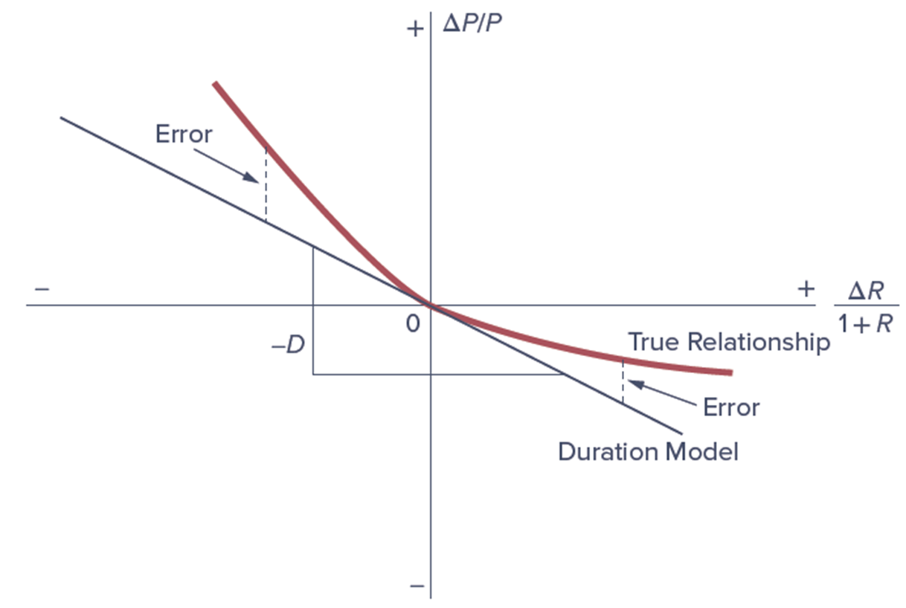
Duration Estimated versus True Bond Price
Access the text alternative for slide images.
Notes:
As Figure 23–2 shows, in actuality, the capital loss effect of rate increases tends to be smaller than the capital gain effect of rate decreases. This is the result of the bond’s price–yield relationship exhibiting a property called convexity rather than linearity, as assumed by the basic duration model (see the more detailed discussion in Chapter 3).

Slide 19
Insolvency Risk Management 1
To ensure survival, an F I manager must protect against the institution against the risk of insolvency.
The primary means of protection against the risk of insolvency and failure is an F I’s equity capital.
Capital is also a source of funds.
Capital is a necessary requirement for growth under existing minimum capital-to-asset ratios set by regulators.
F I managers often prefer low levels of capital in order to generate a higher return on equity (R O E) for stockholders.
The moral hazard problem of deposit insurance exacerbates this tendency.
Strategy results in a greater chance of insolvency.

Slide 20
Insolvency Risk Management 2
Capital Purchase Program, part of the Troubled Asset Relief Program (T A R P) of 2008 to 2009, was designed to encourage U S F I’s to build capital to increase the flow of financing to U S businesses and consumers and to support the U S economy.
Under the program, the Treasury purchased over $205 billion in senior preferred stock issued by F I’s.
In addition to capital injections received as part of the C P P, T A R P provided additional emergency funding to Citigroup ($25 billion) and Bank of America ($20 billion).
Through December 2019, $245 billion of T A R P capital injections had been allocated to D I’s, of which $239.8 billion had been paid back, along with a return of $35.8 billion in dividends and assessments.

Slide 21
Capital
The economic meaning of capital is net worth, the difference between the market value of an F I’s assets and the market value of its liabilities.
Essentially a market value accounting concept.
The market value or mark-to-market value basis uses balance sheet values that reflect current rather than historical prices.
Regulatory- and accounting-defined capital and required leverage ratios are based in whole or in part on historical or book values (B V) accounting concepts.
Book value is the value of assets and liabilities based on their historical costs.
Notes:
Equity capital has many definitions: an economist’s definition of capital may differ from an accountant’s definition, which in turn may differ from a regulator’s definition.

Slide 22
Market Value of Capital
The market value of capital and credit risk:
Declines in current and expected future cash flows on assets lowers the market value of the F I’s asset portfolio.
Decreases in the M V’s of assets are charged directly against the equity owners’ capital or net worth.
Liability holders are only hurt when losses on the asset portfolio exceed F I’s net worth.
Capital acts as “insurance”, protecting liability holders against insolvency risk.
The market value of capital and interest rate risk:
Rising interest rates reduce the market value of the F I’s long-term securities and loans, while floating-rate instruments find their market values largely unaffected if interest rates on such securities are instantaneously reset

Slide 23
The Book Value of Capital 1
Book value (B V) of capital is the difference between the B V of assets and the B V of liabilities.
B V of capital usually comprises the following three components in banking:
Par value of shares – the face value of the common shares issued by the F I times the number of shares outstanding.
Surplus value of shares – the difference between the price the public paid for common shares when originally offered and their par values, times the number of shares outstanding.
Retained earnings – the accumulated value of past profits not yet paid in dividends to shareholders.
  Since these earnings could be paid in dividends, they are part of the equity owners’ stake in the F I.

Slide 24
The Book Value of Capital 2
Book value of capital and credit risk:
Managers of F I’s may resist writing down the values of bad assets as long as possible to try to present a more favorable picture to depositors, shareholders, and regulators.
F I managers can selectively sell assets to inflate their reported capital.
Only pressure from auditors and regulators may force loss recognition and write-downs of the values of problem assets.
Book value of capital and interest rate risk:
Failure of B V accounting systems to recognize the impact of interest rate risk is extreme relative to their partial and lagged recognition of credit risk problems.

Slide 25
Discrepancy between the Market and Book Values of Equity
Degree to which the B V of an F I’s capital deviates from its true economic market value depends on a number of factors, especially:
Interest rate volatility – the higher the interest rate volatility, the greater the discrepancy.
Examination and enforcement – the more frequent are on-site and off-site examinations and the stiffer the examiner/regulator standards regarding charging off problem loans, the small the discrepancy.
Asset trading – the more assets that are traded, the easier it is to assess the true M V of the asset portfolio.
Market-to-book ratio shows the discrepancy between the stock market value of an F I’s equity and the book value of its equity.
Notes:
The higher the market-to-book ratio, the more the book value of capital understates an FI’s true equity or economic net worth position as perceived by investors in the capital market. If the market-to-book value is less than 1, the FI’s equity is perceived by investors in the stock market to be worth less than the book value of its capital.

Slide 26
Market-to-Book Value Ratios for U S D I’s
Bank Name | Bank Holding Company (BHC) Name | Dec 2022 Total Assets ($ billions) | Dec 2022 BV of Equity ($ billions) | Dec 2022 MV of Equity ($ billions) | Dec 2022 Market-to- Book Ratio
JPMORGAN CHASE BANK, NATIONAL ASSOCIATION | JPMORGAN CHASE & CO | $ 3,201.94 | $ 303.67 | $ 393.34 | 1.30
BANK OF AMERICA, NATIONAL ASSOCIATION | BANK OF AMERICA CORP | 2,418.51 | 225.45 | 265.70 | 1.18
CITIBANK, NATIONAL ASSOCIATION | CITIGROUP INC | 1,766.75 | 164.95 | 87.60 | 0.53
WELLS FARGO BANK, NATIONAL ASSOCIATION | WELLS FARGO & COMPANY | 1,717.53 | 161.47 | 157.33 | 0.97
U.S. BANK NATIONAL ASSOCIATION | U.S. BANCORP | 585.14 | 44.72 | 66.73 | 1.49
PNC BANK, NATIONAL ASSOCIATION | PNC FINL SERVICES GROUP INC | 552.31 | 43.89 | 63.70 | 1.45
TRUIST BANK | TRUIST FINANCIAL CORP | 546.23 | 59.94 | 57.09 | 0.95
GOLDMAN SACHS BANK USA | GOLDMAN SACHS GROUP INC | 486.97 | 48.34 | 116.28 | 2.41
CAPITAL ONE, NATIONAL ASSOCIATION | CAPITAL ONE FINANCIAL CORP | 453.31 | 49.55 | 35.48 | 0.72
TD BANK, NATIONAL ASSOCIATION | TORONTO-DOMINION BANK | 386.80 | 42.58 | 116.64 | 2.74
CHARLES SCHWAB BANK | CHARLES SCHWAB CORP | 348.73 | 7.66 | 155.42 | 20.28
THE BANK OF NEW YORK MELLON | BANK OF NY MELLON CORP | 324.65 | 26.75 | 36.79 | 1.38
STATE STREET BANK AND TRUST COMPANY | STATE STREET CORP | 298.02 | 26.58 | 28.46 | 1.07
CITIZENS BANK, NATIONAL ASSOCIATION | CITIZENS FINANCIAL GROUP INC | 226.40 | 23.67 | 19.39 | 0.82
FIRST REPUBLIC BANK |  | 212.64 | 17.45 | 23.88 | 1.37
MORGAN STANLEY | MORGAN STANLEY | 209.66 | 15.97 | 143.69 | 9.00
PRIVATE BANK, NATIONAL ASSOCIATION SILICON VALLEY BANK | SVB FINANCIAL GROUP | 209.03 | 15.46 | 13.60 | 0.88
Source: Authors’ research.
Notes:
Table 23–14 lists the market-to-book ratios for selected U.S. depository institutions as of December 31, 2022. The values range from a low of 0.53 times for Citigroup to 20.28 times for Charles Schwab.

Slide 27
Arguments Against Market Value Accounting
Arguments against market value accounting include the following:
Difficult to implement.
  Especially true for small commercial banks and thrifts with large amounts of nontraded assets, such as small loans, in their balance sheets.
  When market prices or values for assets cannot be determined accurately, marking to market may be done only with error.
Introduces unnecessary degree of variability into F I’s reported earnings – and thus net worth – because paper capital gains and losses on assets are passed through the income statement.
F I’s are less willing to accept longer-term asset exposures if these assets must be continually marked-to-market to reflect changing credit quality and interest rates.

